Slide 1
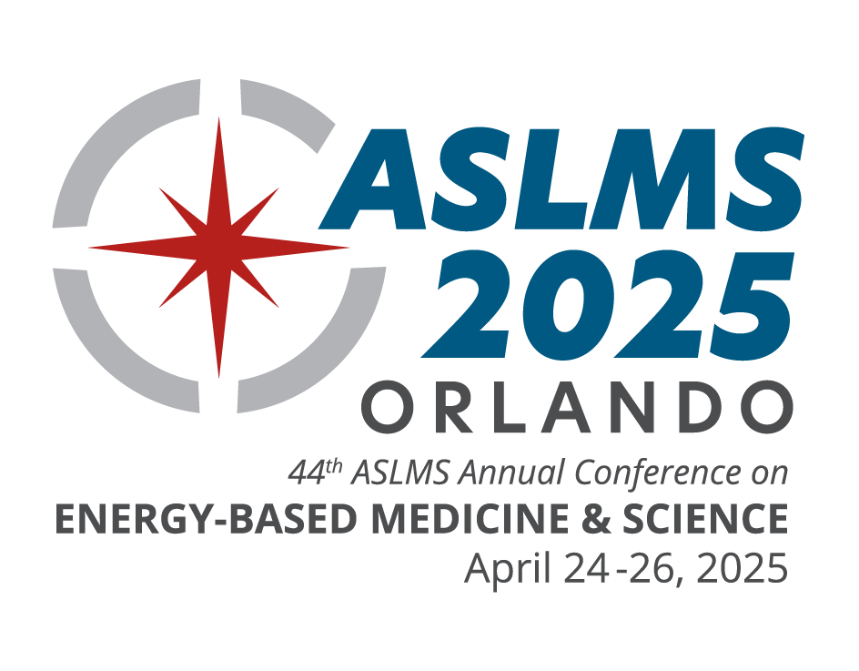
^{CONFERENCE FEATURES}
Pre-Conference Courses
Continuing Education Credits
Industry Sessions
Workshops
Abstract Sessions
Daily Plenary Sessions
Special Events
Evening Receptions
Exhibit Hall
^{KEY DATES}
Join innovative clinicians and scientists from around the world in Orlando, Florida, at the premier international meeting in the field of medical lasers and energy-based technologies.
Call for Abstracts | AUG 19 - NOV 4, 2024*
Late Breaking Abstracts | NOV 11, 2024 - JAN 13, 2025*
Pre-Conference | APR 23, 2024
Conference | APR 24-26, 2024
Exhibits | APR 25-26, 2024
*Submission deadlines end at 11:59 AM CST
LEARN FROM THE WORLD’S LEADING EXPERTS ABOUT:
Body Contouring
Combining Injectables with Devices
Complications and Legal Issues
Dental
Face and Body Lifting/Tightening
Imaging
Hair Growth
Laser Safety
Laser-Assisted Drug Delivery
Pediatrics
Photobiomodulation
Photodynamic Therapy
Pigmented Lesions
Practice Management
Rejuvenation
Resurfacing
Scar Treatment
Skin Cancer
Skin of Color
Social Media
Tattoo Removal
Vascular
Women’s Health
& More!
^{LEARN MORE | ASLMS.ORG}

