Slide 1
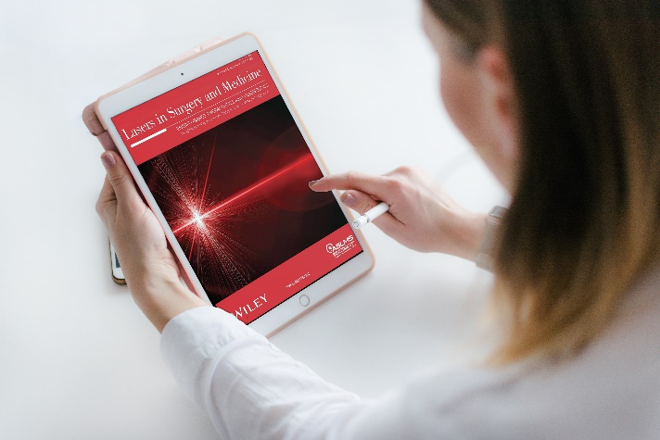
NETWORKING
with key thought leaders driving the future of lasers and energy-based devices in medicine.
The world’s largest professional organization dedicated to promoting
excellence in patient care through the safe and effective use of lasers and other energy-based technologies.
KNOWLEDGE
of the latest research, procedures, and protocols through the Society’s journal, Lasers in Surgery and Medicine, social media, and newsletters.
PROFESSIONAL DEVELOPMENT
via in-person and online resources offering a wide range of valuable educational opportunities.
JOIN TODAY!
aslms.org

Slide 2
Join innovative clinicians and scientists from around the world in Baltimore, Maryland at the premier international meeting in the field of medical lasers and energy-based technologies.
^{CONFERENCE FEATURES}
^{KEY DATES}
Pre-Conference Courses
Continuing Education Credits
Industry Sessions
Workshops
Abstract Sessions
Daily Plenary Sessions
Special Events
Evening Receptions
Exhibit Hall
Call for Abstracts| SEP 8 – NOV 6, 2023
Registration Opens| DEC 7, 2023
Pre-Conference | APR 10, 2024
Conference | APR 11-14, 2024
Exhibits | APR 12-13, 2024
LEARN FROM THE WORLD’S LEADING EXPERTS ABOUT:
Body Contouring
Combining Injectables with Devices
Complications and Legal Issues
Dental
Face and Body Lifting/Tightening
Imaging
Hair Growth
Hair Removal
Laser Safety
Laser-Assisted Drug Delivery
Pediatrics
Photobiomodulation
Photodynamic Therapy
Pigmented Lesions
Plastic Surgery
Practice Management
Rejuvenation
Resurfacing
Scar Treatment
Skin Cancer
Skin of Color
Skin Tightening
Social Media
Tattoo Removal
Vascular
Women’s Health
^{LEARN MORE | ASLMS.ORG}

Slide 3
ASLMS BRINGS THE EDUCATION TO YOU
The ASLMS Online Learning Center features online courses and sessions presented by leaders in the field of lasers and energy-based medicine. Many of the offerings are free or at reduced rates for ASLMS members.
Learning is a lifelong journey. ASLMS Online Learning resources are there to help you every step of the way.
DISCOVER VALUABLE RESOURCES TO ENHANCE YOUR PROFESSIONAL DEVELOPMENT:
On-Demand Courses
24 Hours of Lasers and Energy-Based Devices
Webinars (live and recorded)
Professional Resources
Visit aslms.org to
learn more!
Learn from the experts and get the training you need, on your schedule.

